Slide 1

Kaggle Columbus Competition Presentation by Oliver Foster

Slide 2

Problem & Methodology
Problem:
Columbus wants an algorithm built to target shoppers likely to spend money at their online store based on interaction with their website
Methodology:
Inspect the data with visualizations
Clean the data
Hot-encode categorical columns
Feature engineering
Gridsearch for best combination of model and hyper-parameters

Slide 3
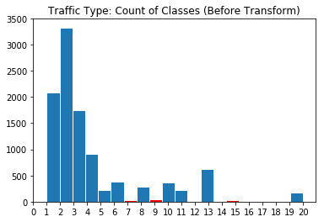
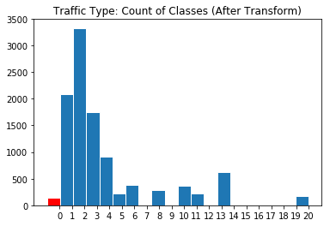
Data Cleaning Problem: Underrepresented Categories
Problem:
Certain features (OperatingSystems, TrafficType, and Browser) had categories with very little representation
Solution:
Assign minority categories to one “Other” category

Slide 4
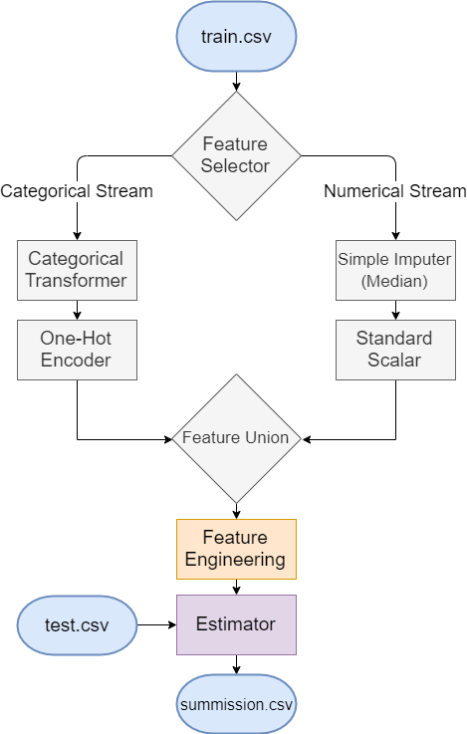
Pipeline & Gridsearch
Feature Engineering Grid:
SelectFromModel
Thresh = [0, '0.5*mean', '0.75*mean', ‘mean’, '1.25*mean‘]
Estimator Grid:
LogReg, Bagging, Boosting, Random Forrest, SVC
All with their own hyper-parameter grids
5-fold Cross-Validation
~350 unique grid combinations (~1750 fits)

Slide 5
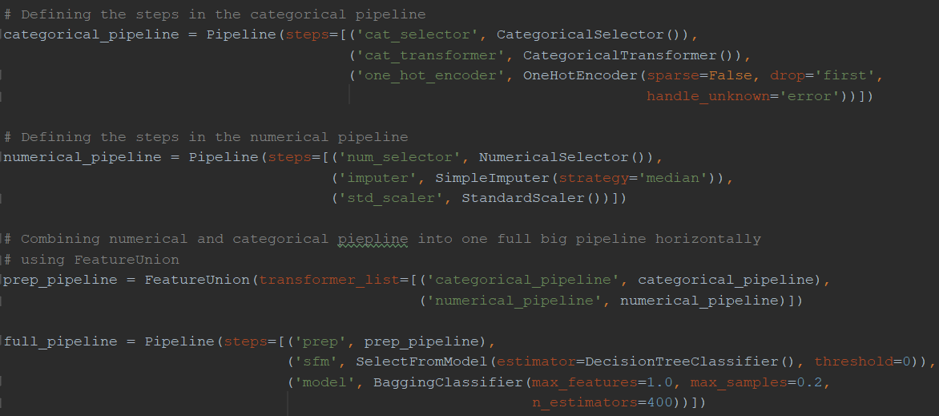
Pipeline in Scikit-Learn

Slide 6

Summary of Results
Data Prep Methodology | Feature Engineering | Base Algorithm | Submission Accuracy
Hot Encoding & Median Imputer | None | Bagging Classifier (Decision Tree Estimator) | 0.91459
Hot Encoding & Median Imputer | SelectFromModel with 0.5*mean threshold | Random Forrest Classifier | 0.90054
Hot Encoding & Median Imputer | (Performed by DNN) | Dense Neural Network Classifier | 0.89621

Slide 7
Reccomendation
Target f-beta score instead of accuracy
Set beta=2 to give preference to recall over precision
OR
Target Average Precision or ROC-AUC & tune your own thresholds to maximize recall/precision

Slide 8
Keep it Simple Stupid (KISS)
First attempt with no feature engineering was the most performant

Slide 9
THANKS!
Any questions?
You can find me at:
oliverfoster27@gmail.com
https://www.linkedin.com/in/oliver-foster-19684a89/

